Slide 1


ALTSCHOOL OF Cybersecurity (BARAKA 2025)
MONTH 3 – WEEK 3

Slide 2
Refresher- week2
Network Security
  Introduction to Network Security
  Types of Threats to Network Security
  Introduction to Firewall and IDS/IPS
  Virtual Private Networks (VPNs)
  Network Security Best Practices
Setting Up VLans
  Configuring VLans and Network Security
  Setting up VLans in Cisco Packet Tracer
  Setting up basic firewall rules

Slide 3
MONTH 3 - WEEK 4
Cloud Computing Concepts
  Introduction to Cloud Computing
  Introduction to Cloud Computing Models (IaaS, SaaS, PaaS)
  Benefits and Challenges of Cloud Computing
  Cloud Service Providers (AWS, Azure, GCP, Huawei & Oracle)
  Cloud Security Basics (Shared Responsibility Model)
  Securing Cloud Infrastructure and Data
  Compliance in the Cloud
  Class Demo and Assignment

Slide 4
Introduction to Cloud Computing
Day 1

Slide 5

WHAT IS Cloud computing ?
Cloud computing is the on-demand delivery of IT resources over the Internet with pay-as-you-go pricing.
Instead of buying, owning, and maintaining physical data centers and servers, you can access technology services, such as computing power, storage, and databases, on an as-needed basis from a cloud provider like Amazon Web Services (AWS), Microsoft Azure, HUAWEI, Google Cloud Platform, Oracle Cloud Platform etc

Slide 6
Cloud computing
Organizations of every type, size, and industry are using the cloud for a wide variety of use cases, such as data backup, disaster recovery, email, virtual desktops, software development and testing, big data analytics, and customer-facing web applications.
For example, healthcare companies are using the cloud to develop more personalized treatments for patients. Financial services companies are using the cloud to power real-time fraud detection and prevention. And video game makers are using the cloud to deliver online games to millions of players around the world.

Slide 7
Cloud computing
Cloud computing is providing developers and IT departments with the ability to focus on what matters most and avoid undifferentiated work like procurement, maintenance, and capacity planning. As cloud computing has grown in popularity, several different models and deployment strategies have emerged to help meet the specific needs of different users. Each type of cloud service, and deployment method, provides you with different levels of control, flexibility, and management. .

Slide 8
Introduction to Cloud Computing MODELS
Day 1

Slide 9
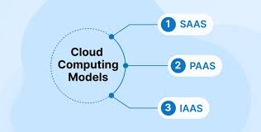
Cloud Computing Models (IaaS, SaaS, PaaS)
The three main types of cloud computing models include Infrastructure as a Service, Platform as a Service, and Software as a Service. Each type of cloud computing models provides different levels of control, flexibility, and management so that you can select the right set of services for your needs.

Slide 10
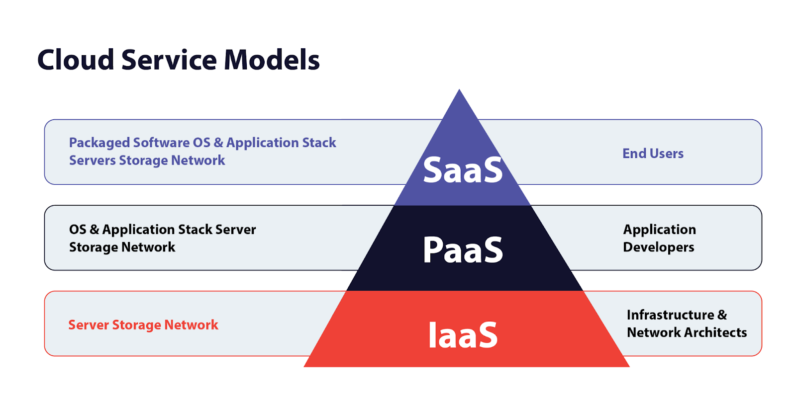
Infrastructure as a Service (IAAS)
Infrastructure as a Service (IaaS)
  IaaS contains the basic building blocks for cloud IT. It typically provides access to networking features, computers (virtual or on dedicated hardware), and data storage space. IaaS gives you the highest level of flexibility and management control over your IT resources. It is most similar to the existing IT resources with which many IT departments and developers are familiar.

Slide 11
Platform as a Service (PAAS)
Platform as a Service (PaaS)
  PaaS vendors remove the need for organizations to manage the underlying infrastructure (usually hardware and operating systems), and this integration allows you to focus on the deployment and management of your applications. This helps you be more efficient, as you don’t need to worry about resource procurement, capacity planning, software maintenance, patching, or any of the other undifferentiated heavy lifting involved in running your application.

Slide 12
Software as a Service (SAAS)
Software as a Service (SaaS)
  SaaS vendors provide you with software applications that are run and managed by the vendor. In most cases, people referring to SaaS are referring to third-party end-user applications. With a SaaS offering you do not have to worry about how the service is maintained or how the underlying infrastructure is managed; you only need think about how you will use that particular piece of software. A common example of a SaaS application is web-based email where you can send and receive email without having to manage feature additions or maintain the servers and operating systems that the email program is running on.

Slide 13
BENEFITS to Cloud Computing
Day 1

Slide 14
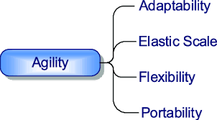
benefits of Cloud computing - AGILITY
AGILITY
  The cloud gives you easy access to a broad range of technologies so that you can innovate faster and build nearly anything that you can imagine. You can quickly spin up resources as you need them–from infrastructure services, such as compute, storage, and databases, to Internet of Things, machine learning, data lakes and analytics, and much more.
  You can deploy technology services in a matter of minutes, and get from idea to implementation several orders of magnitude faster than before. This gives you the freedom to experiment, test new ideas to differentiate customer experiences, and transform your business

Slide 15
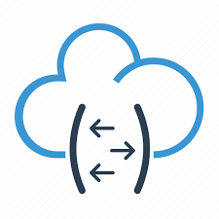
benefits of Cloud computing - ELASTICITY
ELASTICITY
  With cloud computing, you don’t have to over-provision resources up front to handle peak levels of business activity in the future. Instead, you provision the amount of resources that you actually need. You can scale these resources up or down to instantly grow and shrink capacity as your business needs change.

Slide 16

benefits of Cloud computing – COST SAVINGS
COST SAVINGS
  The cloud allows you to trade fixed expenses (such as data centers and physical servers) for variable expenses, and only pay for IT as you consume it. Plus, the variable expenses are much lower than what you would pay to do it yourself because of the economies of scale.

Slide 17

benefits of Cloud computing – speed
DEPLOY GLOBALLY IN MINUTES
  With the cloud, you can expand to new geographic regions and deploy globally in minutes. For example, AWS, Azure and GCP has infrastructure all over the world, so you can deploy your application in multiple physical locations with just a few clicks. Putting applications in closer proximity to end users reduces latency and improves their experience.

Slide 18
Cloud SERVICE PROVIDERS
Day 1

Slide 19
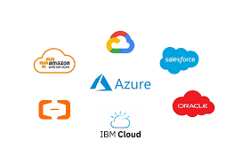
Cloud SERVICE Provider’s
  The term “cloud services” refers to a wide range of services delivered to companies and customers over the Internet. These services make it easy for employees to have access to various business applications and information. Whether they’re aware of it, from checking email to collaborating on documents, most employees use cloud services throughout the workday. Cloud computing vendors and service providers fully manage services provided through cloud computing. You don’t have to host applications on your servers. Instead, they can be accessed from the servers of a cloud service provider.

Slide 20
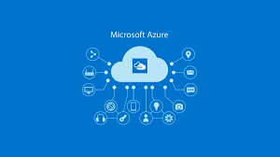
Cloud SERVICE Provider - AZURE
  Microsoft Azure is a cloud computing platform and service offered by Microsoft that provides a wide range of solutions including computing, storage, networking, databases, AI, and DevOps tools. It enables organizations to build, deploy, and manage applications through Microsoft-managed data centers across the globe. Azure supports hybrid cloud setups, multiple programming languages, and frameworks, making it ideal for businesses of all sizes to scale efficiently and securely.

Slide 21

Cloud SERVICE Provider - AWS
  Amazon Web Services (AWS) is a comprehensive cloud computing platform by Amazon that offers on-demand services such as computing power, storage, databases, machine learning, and analytics. It enables businesses to build and scale applications efficiently through a global network of data centers. Known for its flexibility, security, and vast service offerings, AWS supports various workloads including web hosting, big data, DevOps, and enterprise applications.

Slide 22
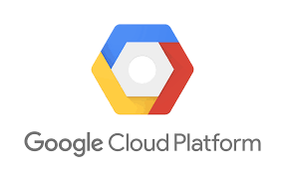
Cloud SERVICE Provider - GCP
  Google Cloud Platform (GCP) is a suite of cloud computing services offered by Google that enables organizations to build, deploy, and scale applications using Google’s infrastructure. It provides services for computing, storage, databases, machine learning, analytics, and more. GCP is known for its strong data analytics capabilities, AI tools, and integration with open-source technologies. It supports modern cloud-native development and offers a secure, scalable environment for businesses of all sizes.

Slide 23
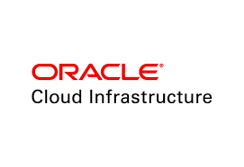
Cloud SERVICE Provider - ORACLE
  Oracle Cloud is a cloud computing platform offered by Oracle that provides a comprehensive suite of services, including computing, storage, databases, analytics, AI, and enterprise applications. It is known for its powerful database services, especially Oracle Autonomous Database, and is designed for high performance, security, and scalability. Oracle Cloud supports hybrid and multi-cloud environments, making it ideal for enterprise workloads and mission-critical applications.

Slide 24
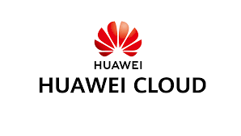
Cloud SERVICE Provider - HUAWEI
  Huawei Cloud is a cloud computing platform provided by Huawei, offering a wide range of services including computing, storage, AI, big data, and networking. It supports digital transformation for businesses across various industries with a focus on innovation, security, and cost-efficiency. Known for its strong presence in Asia, Huawei Cloud enables scalable and intelligent cloud solutions, and supports hybrid and multi-cloud environments.

Slide 25
Cloud SHARED RESPONSIBILITY
Day 1

Slide 26
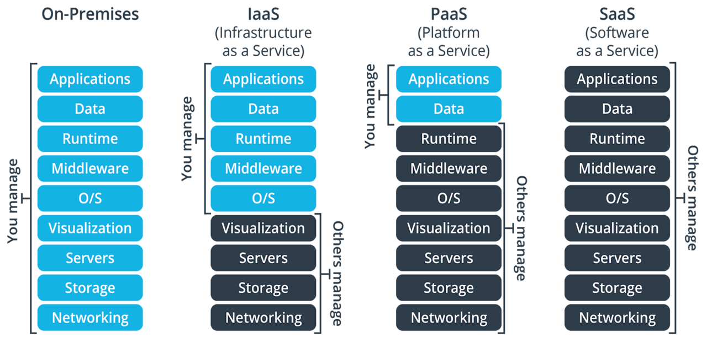
RESPONSIBILITY MATRIX

Slide 27
Securing Cloud Infrastructure and Data
Day 1

Slide 28
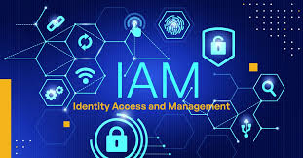
Securing Cloud Infrastructure and Data
  Identity and Access Management (IAM)
    IAM is the framework of policies and technologies that ensures the right individuals have the appropriate access to technology resources in cloud environments. It is foundational to securing cloud infrastructure, as it controls who can access what, when, and how.

Slide 29

Securing Cloud Infrastructure and Data
  Network Security
    Network security is a critical pillar in protecting cloud infrastructure by controlling and monitoring the flow of data between systems, users, and services. It ensures that only authorized traffic is allowed, prevents unauthorized access, and detects malicious activities within the network.

Slide 30
Refresher- LAST CLASS
Identity and Access Management
  Introduction to Identity and Access Management Principles
  Core Concepts - Identification, Authentication, Authorization, Accountability
  Identity and Access Management (IAM) Components and Architecture
  IAM Architecture
  IAM Architecture Models
  Authentication Methods

Slide 31
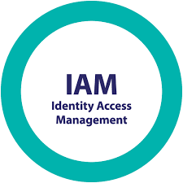
Identity AND ACCESS MANAGEMENT
  Identity and Access Management (IAM) is a framework of policies and technologies that ensures the right individuals have access to digital resources within an organization. It involves managing and controlling who can access what applications and resources, as well as what actions they can perform. IAM models can be categorized into four main areas: Identity Governance and Administration (IGA), Access Management (AM), Privileged Access Management (PAM), and Active Directory Management (ADMgmt).

Slide 32
What IAM is and what it does
  IAM gives secure access to company resources—like emails, databases, data, and applications—to verified entities, ideally with a bare minimum of interference. The goal is to manage access so that the right people can do their jobs and the wrong people, like hackers, are denied entry.

Slide 33
What IAM is and what it does
  The need for secure access extends beyond employees working on company machines. It also includes contractors, vendors, business partners, and people working on personal devices. IAM makes sure that each person who should have access has the right level of access at the right time on the right machine. Because of this, and the role it plays in an organization’s cybersecurity, IAM is a vital part of modern IT.
  With an IAM system, the organization can quickly and accurately verify a person’s identity and that they have the necessary permissions to use the requested resource during each access attempt.

Slide 34
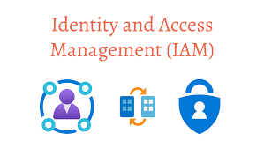
HOW IAM WORKS
  There are two parts to granting secure access to an organization’s resources: Identity management and access management.
    Identity management
    and Access management.

Slide 35
HOW IAM WORKS
    Identity management checks a login attempt against an identity management database, which is an ongoing record of everyone who should have access. This information must be constantly updated as people join or leave the organization, their roles and projects change, and the organization’s scope evolves.
    Examples of the kind of information that’s stored in an identity management database include employee names, job titles, managers, direct reports, mobile phone numbers, and personal email addresses. Matching someone’s login information like their username and password with their identity in the database is called authentication.

Slide 36
HOW IAM WORKS
    For added security, many organizations require users to verify their identities with something called multifactor authentication (MFA). Also known as two-way verification or two-factor authentication (2FA). MFA is more secure than using a username and password alone. It adds a step to the login process where the user must verify their identity with an alternate verification method. These verification methods can include mobile phone numbers and personal email addresses. The IAM system usually sends a one-time code to the alternate verification method, which the user must enter into the login portal within a set time period.

Slide 37
HOW IAM WORKS
    Access management is the second half of IAM. After the IAM system has verified that the person or thing that’s attempting to access a resource matches their identity, access management keeps track of which resources the person or thing has permission to access. Most organizations grant varying levels of access to resources and data and these levels are determined by factors like job title, tenure, security clearance, and project.
    Granting the correct level of access after a user’s identity is authenticated is called authorization. The goal of IAM systems is to make sure that authentication and authorization happen correctly and securely at every access attempt.

Slide 38
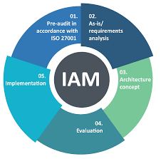
IMPORTANCE OF IAM
    One reason IAM is an important part of cybersecurity is that it helps an organization’s IT department strike the right balance between keeping important data and resources inaccessible to most but still accessible to some. IAM makes it possible to set controls that grant secure access to employees and devices while making it difficult or impossible for outsiders to get through.

Slide 39
IMPORTANCE OF IAM
    Another reason that IAM is important is that cybercriminals are evolving their methods daily. Sophisticated attacks like phishing emails are one of the most common sources of hacking and data breaches and they target users with existing access. Without IAM, it’s difficult to manage who and what has access to an organization’s systems. Breaches and attacks can run rampant because not only is it difficult to see who has access, it’s also difficult to revoke access from a

Slide 40
BENEFITS OF IAM
The right access for the right people
With the ability to create and enforce centralized rules and access privileges, an IAM system makes it easier to ensure that users have access to the resources they need without making it possible for them to access sensitive information they don’t need. This is known as role-based access control (RBAC). RBAC is a scalable way to restrict access to only the people who need that access to perform their role. Roles can be assigned based on a fixed set of permissions or custom settings.

Slide 41
BENEFITS OF IAM
Unhindered productivity
As important as security is, productivity and user experience are also important. As tempting as it might be to implement a complicated security system to prevent breaches, having multiple barriers to productivity like multiple logins and passwords is a frustrating user experience. IAM tools like single sign-on (SSO) and unified user profiles make it possible to grant secure access to employees across multiple channels like on-premises resources, cloud data, and third-party applications without multiple logins.

Slide 42
BENEFITS OF IAM
Protection from data breaches
While no security system is infallible, using IAM technology significantly reduces your risk of data breaches. IAM tools like MFA, passwordless authentication, and SSO give users the ability to verify their identities using more than just a username and password, which can be forgotten, shared, or hacked. Expanding user login options with an IAM solution reduces that risk by adding an additional layer of security to the login process that can’t as easily be hacked or shared.

Slide 43
BENEFITS OF IAM
Data encryption
One of the reasons IAM is so effective at elevating an organization’s security is that many IAM systems offer encryption tools. These protect sensitive information when it’s transmitted to or from the organization and features like Conditional Access enable IT administrators to set conditions such as device, location, or real-time risk information as conditions for access. This means the data is safe even in the event of a breach because the data can only be decrypted under verified conditions.

Slide 44
BENEFITS OF IAM
Less manual work for IT
By automating IT department tasks like helping people reset their passwords, unlock their accounts, and monitoring access logs to identify anomalies, IAM systems can save IT departments time and effort. This frees up the IT department to focus on other important tasks like implementing a Zero Trust strategy throughout the rest of the organization. IAM is essential to Zero Trust, which is a security framework built on the principles of verifying explicitly, using least privileged access, and assuming breach.

Slide 45
BENEFITS OF IAM
Improved collaboration and efficiency
Seamless collaboration between employees, vendors, contractors, and suppliers is essential to keeping up with the pace of modern work. IAM enables this collaboration by making sure that not only is collaboration secure, it’s also fast and easy. IT administrators can also build role-based automated workflows to speed up the permissions processes for role transfers and new hires, which saves time during onboarding.

Slide 46
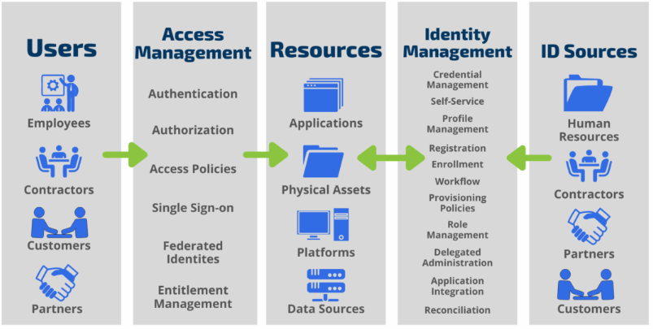
IAM ARCHITECTURE

Slide 47
Refresher- LAST CLASS
Identity and Access Management
  Introduction to Identity and Access Management Principles
  Core Concepts - Identification, Authentication, Authorization, Accountability
  Identity and Access Management (IAM) Components and Architecture
  IAM Architecture
  IAM Architecture Models
  Authentication Methods

Slide 48
MONTH 4 - WK1
Access Control Models
  Introduction to Access Control Models
  Overview of Access Control Models
  Privilege Management
  Least Privilege Principles
  User and Group Management
  Authentication Methods
  AWS/AZURE IAM Basic Demo

Slide 49
Introduction to Access Control Models
Day 2

Slide 50
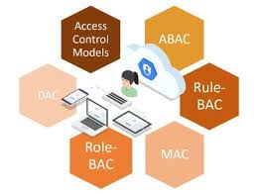
ACCESS CONTROL MODELS
Access Control
Access control is a fundamental aspect of information security, ensuring that only authorized users can access specific resources in a system. Different models of access control offer unique methods and benefits, catering to various organizational needs.

Slide 51
ACCESS CONTROL MODELS
Access Control Model
The three primary models are
  Role-Based Access Control (RBAC),
  Attribute-Based Access Control (ABAC)
  Discretionary Access Control (DAC).
  Each model has its distinctive features, advantages, and ideal use cases.

Slide 52
ACCESS CONTROL MODELS
Access Control Model
The three primary models are
  Role-Based Access Control (RBAC),
  Attribute-Based Access Control (ABAC)
  Discretionary Access Control (DAC).
  Each model has its distinctive features, advantages, and ideal use cases.

Slide 53
Role-Based Access Control (RBAC)
The Role-Based Access Control (RBAC) is one of the most widely used access control models. In RBAC, permissions are assigned to roles, and users are then assigned to these roles. This model simplifies management by grouping permissions into roles rather than assigning permissions directly to users.

Slide 54
OVERVIEW OF ACCESS CONTROL MODELS - RBAC
The Role-Based Access Control (RBAC) is one of the most widely used access control models. In RBAC, permissions are assigned to roles, and users are then assigned to these roles. This model simplifies management by grouping permissions into roles rather than assigning permissions directly to users.
Key Features of RBAC:
1. Roles: Defined based on job functions within an organization.
2. Permissions: Assigned to roles, not directly to users.
3. User-Role Assignment: Users are granted roles that provide them with the necessary permissions.

Slide 55
OVERVIEW OF ACCESS CONTROL MODELS - (RBAC)
Benefits of RBAC:
Simplified Management: Easier to manage permissions by handling roles instead of individual users.
Scalability: Suitable for large organizations where roles can be reused across different users.
Least Privilege Enforcement: Ensures users have only the necessary access to perform their job functions.
Audit and Compliance: Simplifies auditing and compliance processes by providing clear mappings between roles and permissions.
Use Cases for RBAC:
Large Enterprises: Where predefined roles can be easily assigned to numerous employees.
Regulated Industries: Such as healthcare and finance, where compliance and auditing are critical.

Slide 56
OVERVIEW OF ACCESS CONTROL MODELS - (ABAC)
Attribute-Based Access Control (ABAC)
Attribute-Based Access Control (ABAC) is a more dynamic and flexible model. It makes access decisions based on attributes associated with users, resources, and the environment. These attributes can include user roles, department, time of access, and more.
Key Features of ABAC:
1. Attributes: Define characteristics of users, resources, and environmental conditions.
2. Policies: Set rules that evaluate attributes to grant or deny access.
3. Dynamic Access Decisions: Access is determined in real-time based on current attributes.

Slide 57
OVERVIEW OF ACCESS CONTROL MODELS - (ABAC)
Benefits of ABAC:
Flexibility: Can handle complex access control scenarios and dynamically adapt to changes.
Granularity: Allows fine-grained access control by considering multiple attributes.
Context-Aware: Can make access decisions based on real-time contextual information.
Use Cases for ABAC:
Dynamic Environments: Where access decisions need to adapt to changing conditions, such as in cloud computing.
Highly Regulated Data: Requiring fine-grained control, like in government and defense sectors.
Collaborative Environments: Where users from different organizations need varying levels of access.

Slide 58
OVERVIEW OF ACCESS CONTROL MODELS - (DAC)
Discretionary Access Control (DAC)
Discretionary Access Control (DAC), a more advanced type of access control, grants access based on the discretion of the resource owner. In DAC, the owner of a resource decides who can access it and what kind of access they can have.
Key Features of DAC:
1. Resource Ownership: Users can create resources and control access to them.
2. Access Control Lists (ACLs): Lists specifying which users or groups have access to a resource and the type of access allowed.
3. User Discretion: Owners have complete control over their resources.

Slide 59
OVERVIEW OF ACCESS CONTROL MODELS - (DAC)
Benefits of DAC:
Flexibility: Resource owners can make quick and specific access decisions.
User Empowerment: Empowers users to control their own data.
Simplicity: Easy to understand and implement in small environments.
Use Cases for DAC:
Small Organizations: Where the number of users and resources is manageable.
Personal Data: Where users need to control access to their own files.
Ad-hoc Projects: With temporary teams needing flexible access control.

Slide 60
OVERVIEW OF ACCESS CONTROL MODELS
Selecting the appropriate access control model depends on various factors, including organizational size, regulatory requirements, and the complexity of the access control needs.
  RBAC is ideal for large organizations with well-defined roles and responsibilities.
  ABAC suits dynamic and complex environments requiring fine-grained, context-aware access decisions.
  DAC works best in smaller, less structured settings where resource owners need control over their data.

Slide 61
PRIVILEDGE MANAGEMENT
Day 2

Slide 62
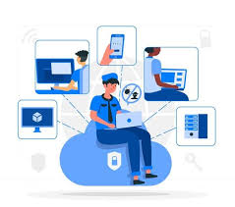
PRIVILEGE MANAGEMENT
Privilege management, also known as Privileged Access Management (PAM), is a cybersecurity practice focused on controlling and securing access to privileged accounts within an organization. It ensures that users only have the access they need to perform their jobs, limiting potential damage from unauthorized access or misuse. PAM involves managing the lifecycle of privileged accounts, monitoring their usage, and enforcing security policies to protect sensitive resources.

Slide 63

PRIVILEGE MANAGEMENT
For cybercriminals, privileged user accounts are nothing more than profitable targets. Why? Because they have elevated permissions, allowing them to gain access to sensitive information and make changes to applications and systems.

Slide 64
PRIVILEGE MANAGEMENT
For cybercriminals, privileged user accounts are nothing more than profitable targets. Why? Because they have elevated permissions, allowing them to gain access to sensitive information and make changes to applications and systems.

Slide 65
PRIVILEGE MANAGEMENT – WHY IS IT IMPORTANT
Let’s discuss privileged accounts. As the name suggests, privileged account management is related to privileged access management. TPAM tools track and secure privileged accounts to ensure business safety.

Slide 66
PRIVILEGE MANAGEMENT – WHY IS IT IMPORTANT
Let’s discuss privileged accounts. As the name suggests, privileged account management is related to privileged access management. TPAM tools track and secure privileged accounts to ensure business safety.
Privileged accounts are special because they have more control. These accounts can be in different forms and places, like on a company’s own servers or in the cloud. Sometimes, more than one person can use these accounts temporarily.

Slide 67
PRIVILEGE MANAGEMENT – WHY IS IT IMPORTANT
For instance, the root account on a Mac is a type of privileged account. An account owner for Microsoft Azure/AWS is another. A corporate account for the official Altschool LMS profile is yet another form.
These accounts are risky because they can be hacked. Hackers want to get into these accounts because they can access a lot of a company’s important information and systems.

Slide 68
PRIVILEGE MANAGEMENT – HOW IT WORKS
Imagine this: Special passwords are kept in a very secure place. Users with special access use a system called PAM to get into their accounts. This access is recorded and is only for certain tasks.
For safety, the PAM system often asks why someone is using the account or needs a manager’s okay. Users usually don’t see the actual passwords; they get into their accounts through PAM.
Privileged Access Management administrators can follow user activities via the PAM portal and even manage live sessions in real time if needed. Besides, new PAM systems use machine learning to track deviations and risk scoring to immediately alert the administrator of dangerous activities.

Slide 69
PRIVILEGE MANAGEMENT – BENEFITS
Enhanced security
Privileged Access Management (PAM) helps protect against cyberattacks. It deals with the problem of users having too many passwords or using the same password everywhere. PAM helps manage passwords better and alerts you to possible attacks.
Better protection against insider threats
As surprising as it may sound, a large number of attacks come from within the organization. If it’s not an “inside job”, it’s usually former employees who haven’t been stripped of unnecessary privileges to prevent access after departure.

Slide 70
PRIVILEGE MANAGEMENT – BENEFITS
Increased productivity
PAM makes it easier and faster for users with special access to log into the systems they need. It reduces the hassle of remembering lots of passwords and lets users manage access from one place.
Ensures compliance
PAM helps companies follow laws by managing special access and keeping records of who accessed what. It can limit access to important systems, ask for extra approvals, and use stronger security checks

Slide 71
LEAST PRIVILEGE
Day 2

Slide 72
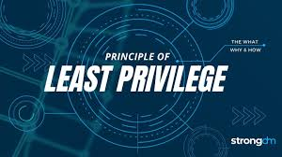
LEAST PRIVILEGE PRINCIPLES
The principle of least privilege, also known as PoLP, is a core concept in cybersecurity that dictates users should only have access to the minimum resources and data necessary to perform their job functions. This principle limits the potential attack surface, reducing the impact of a security breach by restricting the amount of damage a compromised account can cause.

Slide 73
LEAST PRIVILEGE PRINCIPLES – HOW IT WORKS
The principle of least privilege works by limiting the accessible data, resources, applications and application functions to only that which a user or entity requires to execute their specific task or workflow. Without incorporating the principle of least privilege, organizations create over-privileged users or entities that increase the potential for breaches and misuse of critical systems and data.

Slide 74
LEAST PRIVILEGE PRINCIPLES – WHY IS IT IMPORTANT
The principle of least privilege is an important information security construct for organizations operating in today’s hybrid workplace to help protect them from cyberattacks and the financial, data and reputational losses that follow when ransomware, malware and other malicious threats impact their operations.
The principle of least privilege strikes a balance between usability and security to safeguard critical data and systems by minimizing the attack surface, limiting cyberattacks, enhancing operational performance and reducing the impact of human error

Slide 75
LEAST PRIVILEGE PRINCIPLES – BENEFITS
Minimizes the attack surface, diminishing avenues a malicious actor can use to access sensitive data or carry out an attack by protecting superuser and administrator privileges.
Reduces malware propagation by not allowing users to install unauthorized applications. The principle of least privilege also stops lateral network movement that can launch an attack against other connected devices by limiting malware to the entry point.
Improves operational performance with reductions in system downtime that might otherwise occur as a result of a breach, malware spread or incompatibility issues between applications.
Safeguards against human error that can happen through mistake, malice or negligence.

Slide 76
USER AND GROUP MANAGEMENT
Day 2

